Slide 1

YESHWANTRAO CHAVAN COLLEGE OF ENGINEERING
Department of Computer Science and Engineering
Speak2Summarize : Daily Recap
Group No : 28
Team Members :
Hemanshu Waghmare
Rishabh Jain
Dhruv Dalvi
Sanket Asole
Yuvraj Chavan
Guided By:
Prof. Chanchla Tripathi
Department of Computer Science and Engineering

Slide 2
PROBLEM STATEMENT
Many people find it challenging to remember daily tasks and important details, leading to decreased productivity, missed responsibilities, and heightened stress. An effective solution is crucial for improving task management and memory recall.

Slide 3
ABSTRACT
We present a method that takes audio as an input and generates a written or text summary of the same as an output. created the text summary using text summarizing methods. This proposed method is implemented in machine learning. In today's information-rich environment, finding relevant content quickly can be challenging. Automatic document summarization, using natural language processing, helps extract key information from extensive texts. Text summarization techniques, whether extraction-based or abstraction-based, aim to condense lengthy content into concise summaries. Our product, Speak2Summarize, addresses this common challenge by providing users with clear and concise text summaries of their interactions and daily meetings with given timestamps.

Slide 4
OBJECTIVES
1) Memory recall and Optimized task management.
2) Provide concise text summaries of their Daily interactions and meetings with given timestamps.

Slide 5
METHODOLOGY

Slide 6
METHODOLOGY
Speech-to-text
Data Preprocessing | Model Training | Decoding and Evaluation
Dataset Collection: Gather a dataset with audio for the Model Training task. (Common voices) Audio Segmentation: Split the audio into individual speaker segments. (Pyannote.audio) Feature Extraction: Convert audio segments into numerical features. ( Pydub, Numpy) | A. Sequence to Sequence Models: Architectures like Recurrent Neural Networks (RNNs) or Transformers are commonly used for speech recognition ( ASR ). Whisper (OpenAI) Wav2Vec 2.0 (Facebook) DeepSpeech (Mozilla) | Loss Function: Use a suitable loss function like Connectionist Temporal Classification (CTC) to handle variable-length input and output sequences. Beam Search: Use beam search to find the most probable text sequence given the model's output probabilities. Metrics: Evaluate the model using metrics like Word Error Rate (WER) or Character Error Rate (CER).

Slide 7
METHODOLOGY
Text-to-summary
Text Preprocessing | Feature Extraction | Summarization Model | Evaluation
Tokenization: Breaking text into individual words or subwords. Stop word removal: Eliminating common words with little semantic value. Stemming or lemmat-ization: Reducing words to their root form. | Generate numerical represe-ntations of text using techniques like TF-IDF, word embeddings (Word2Vec, GloVe), or contextual embeddings (BERT). Text Normalization: Clean and standardize the corresponding text transcripts (lowercase, punctuation handling, etc.). | Extractive Summarization: Identify and extract the most important sentences from the text. Techniques include TextRank, Latent Semantic Analysis (LSA), or supervised learning models. Abstractive Summarization: Generate new text that captures the essential information of the original text. Employ sequence-to-sequence models like recurrent neural networks (RNNs), long short-term memory (LSTM), or transformer-based models (e.g., BART, T5). | Assess the quality of the generated summaries using metrics

Slide 8
PLAN OF PROJECT
Module 1: Audio Data Preprocessing
Collect and preprocess the dataset.
Classification of speakers using speech diarization.
Segmentation of the data.
Module 2: Speech to Text (STT)
Implement STT model for the dataset.
Test the accuracy using WER(word error rate), CER(character error rate).
Add post processing components such as annotations.

Slide 9
PLAN OF PROJECT
Module 3: Text Preparation for Summarization
Prepare and tokenize the text data.
Remove stopwords.
Perform necessary data cleaning and formatting.
Module 4: Text Summarization
Compile the cleaned data using RNN/transformer layers.
Test and validate the summarization results.
Module 5: Hardware Implementation
A device consisting of microphone and memory card for recording.

Slide 10
Work Carried Out

Slide 11
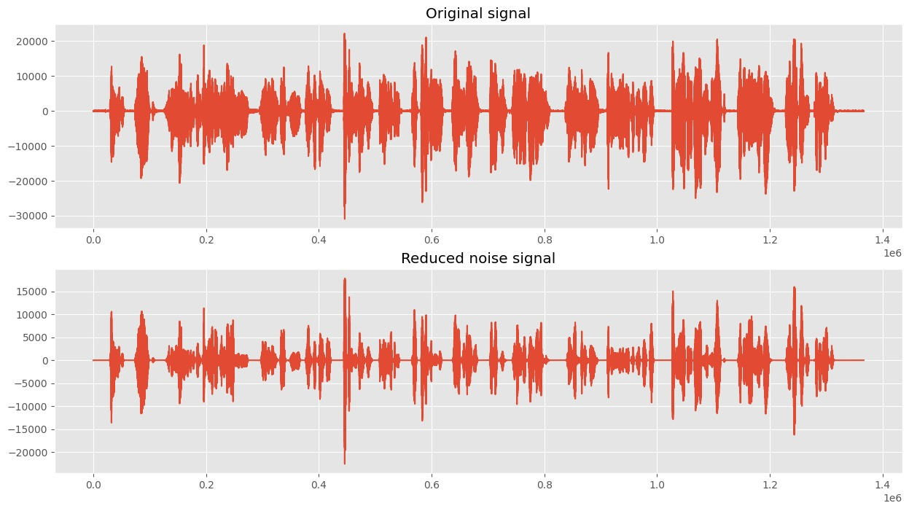
Noise Reduction
Gathered dataset with audios and performed Normalization and Noise reduction
.

Slide 12
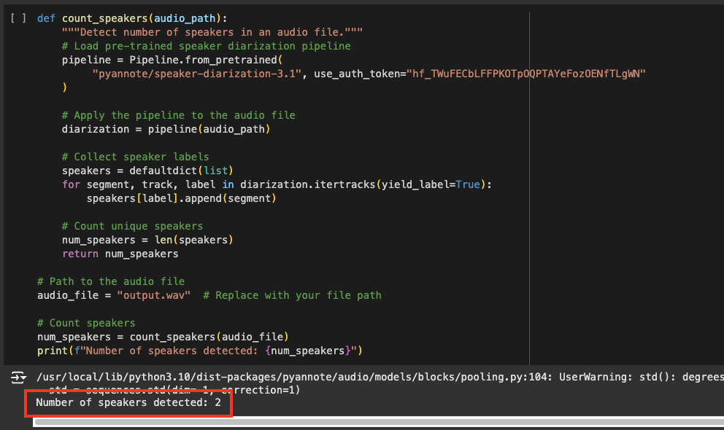
Speaker Diarization
Processed the audio file which is converted to .wav format to find out how many distinct people are speaking in the current audio file.
.

Slide 13
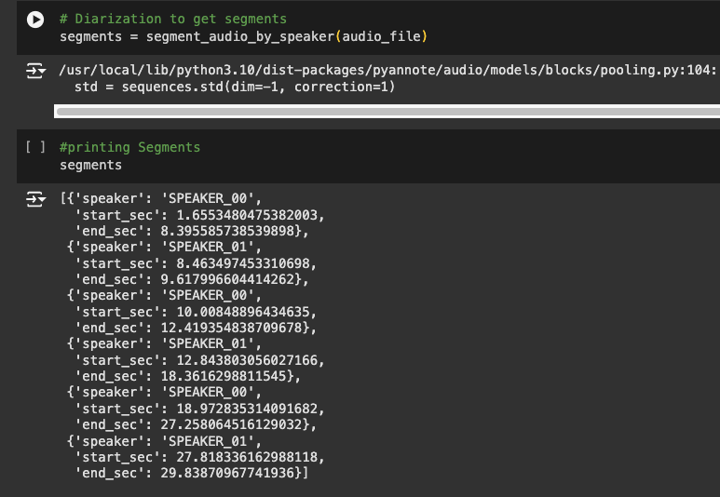
Identifying time period for each speaker
After diarization, audio segments or time range for each speaker is computed so that we can that classify each unique audio segment and map it to their respective speaker

Slide 14
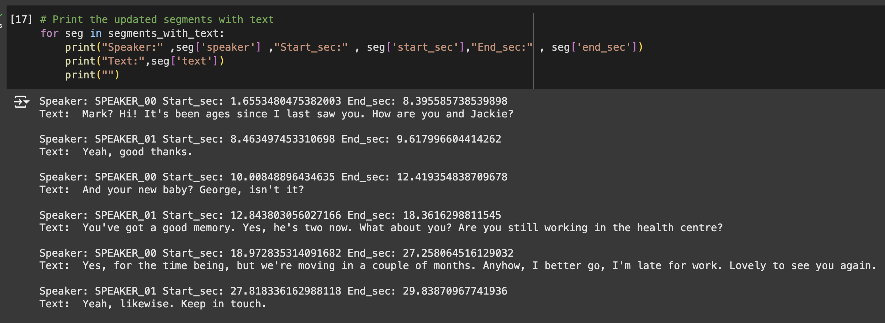
Transcribing
The audio segment for each speaker was converted to text and mapped to the speaker who spoke that sentence

Slide 15
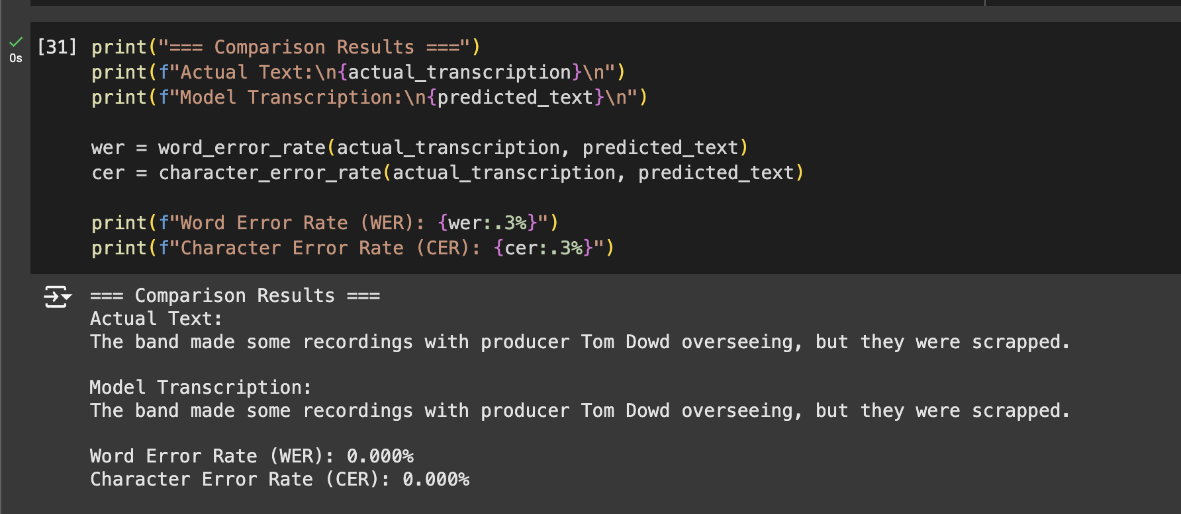
Accuracy Measurement

Slide 16
CONCLUSION
This project successfully completed two critical modules focusing on processing and understanding audio data:
Module 1: Achieved preprocessing of audio datasets by implementing speaker classification through speech diarization and segmentation techniques.
Module 2: Implemented a Speech-to-Text (STT) model that converts audio into higly accurate text. The model's performance was evaluated using metrics like Word Error Rate (WER) and Character Error Rate (CER).

Slide 17
Thank You!

